Slide 1
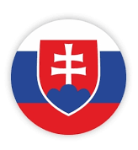
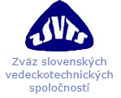
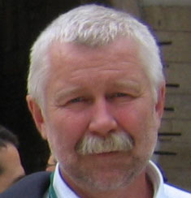
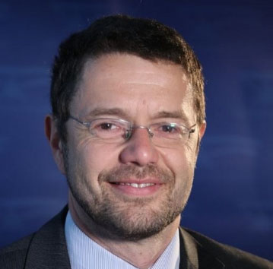
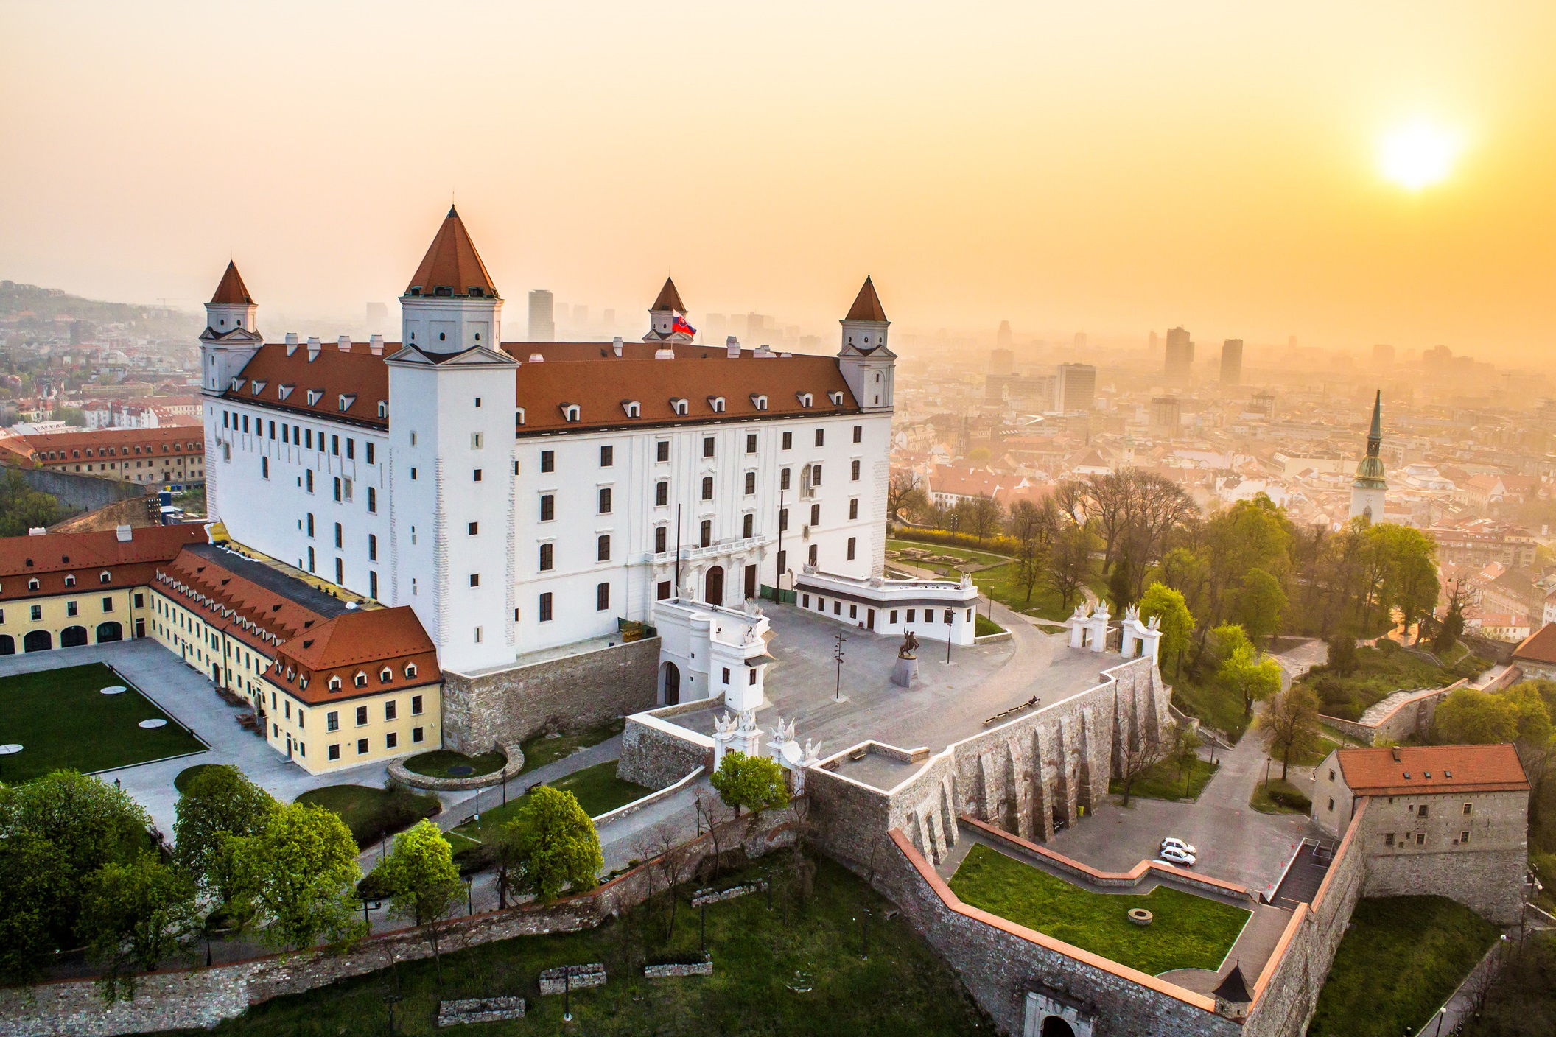
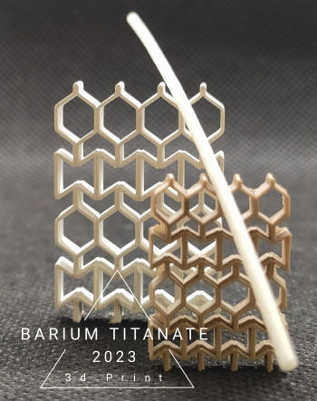
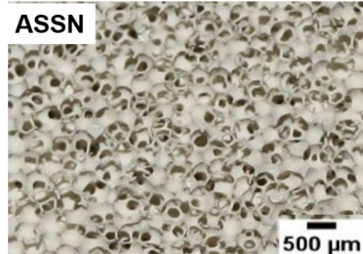
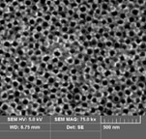
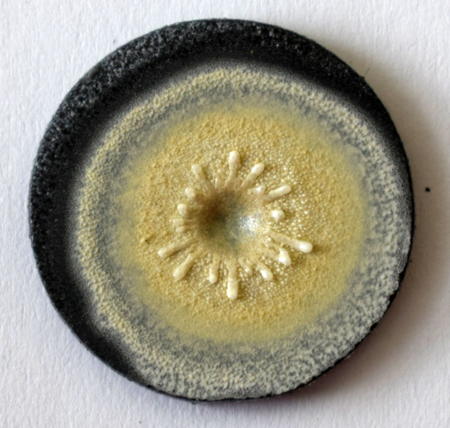
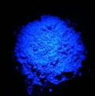
Presentation & missions
Slovak
silicate
Society
Slovenská silikátová spoločnosť
The Slovak Silicate Society (SSS) is an independent, volunteer society of scientists and manufacturers from the field of silicates and ceramics. The society was created in 1990, after splitting the Czechoslovak Silicate Society. It is located in Bratislava, Slovakia. an is a member of the Association of the Slovak Scientific and Technical Societies.
CONTESTS
The Contest of the young inorganic chemists and ceramists
is organized every year and the representative of Slovakia is selected from this contest to attend the ECerS Student Speech Contest. A “Best Thesis Contest” is also organized every year at the Slovak Technical University, Bratislava.
The annual meeting of SSS is held every year.
Pavol Šajgalík
President
Ceramics laboratories
Institute of Inorganic Chemistry, Slovak Academy
of Sciences in Bratislava
Institute of Materials Research, Slovak Academy
of Sciences in Košice
FunGlass centre of excellence, Alexander Dubček University of Trečín
Faculty of Chemical and Food Technology, Slovak Technical University in Bratislava
Department of Ceramics, Technical University of Košice
Dušan Galusek
vice-president
www.sss.sav.sk
94
Individual
members
4
Industrial/
institutional
members
porous Si₃N₄
UHTCs
TiO₂ nanotubes
LaSi₃N₅!Ce
phophor

